Slide 1
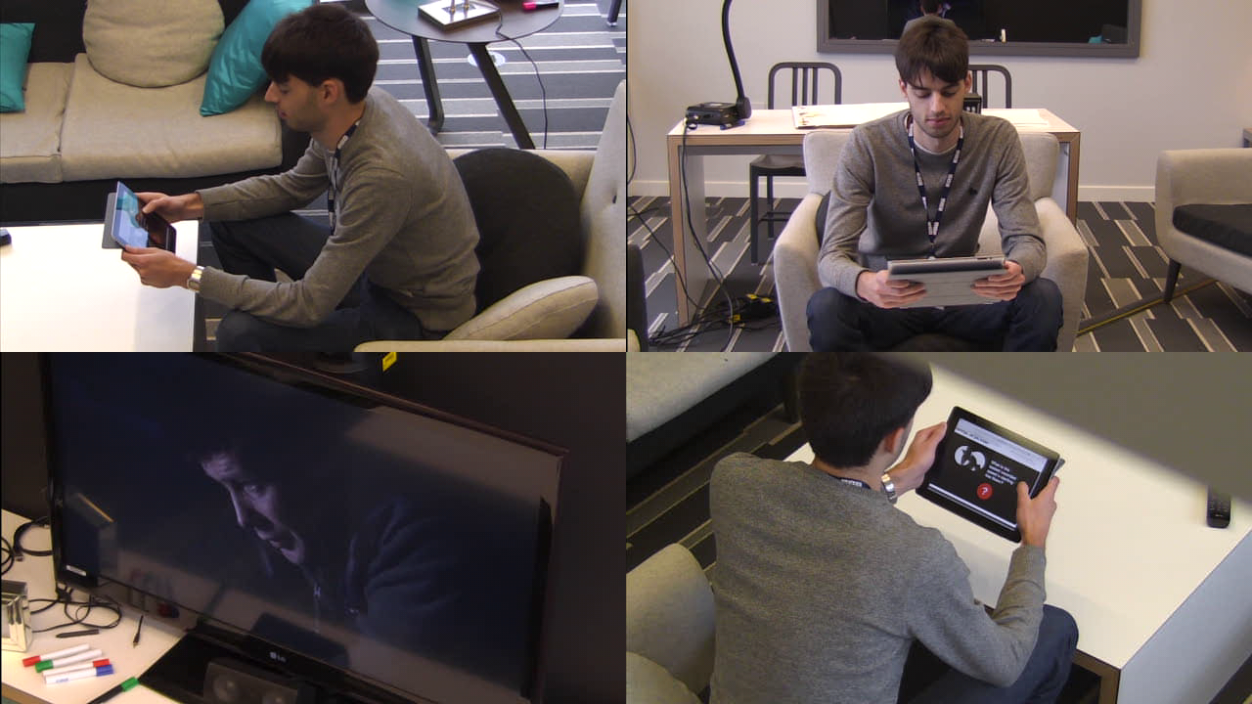
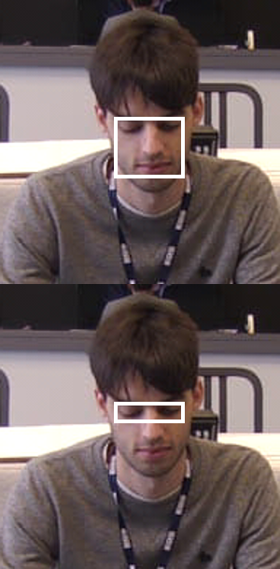
Reproducible Computer Science caroline.jay@manchester.ac.uk
More info:
http://idinteraction.cs.manchester.ac.uk
‘ABC: Using Object Tracking to Automate Behavioural Coding.’ CHI 2016.
SSI blog post coming soon!
Funded by EPSRC grant EP/M017133/1

