Slide 1
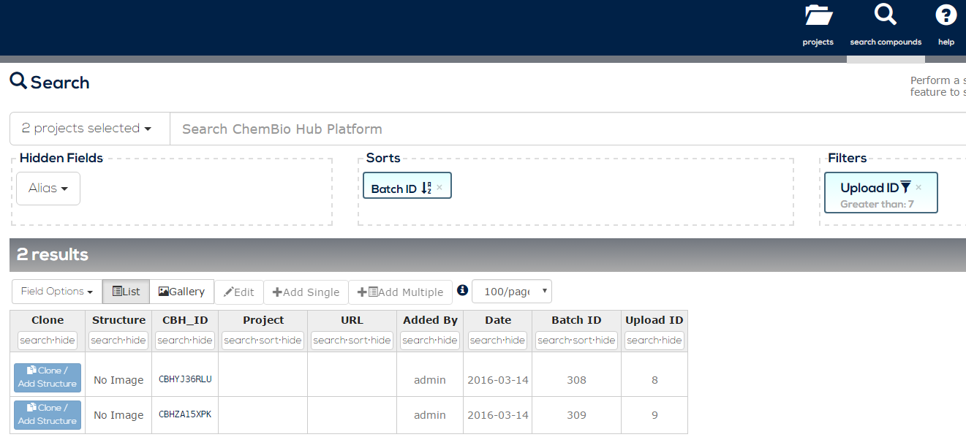
A flexible* Research Data Management platform
Check out our applications - https://chembiohub.ox.ac.uk/applications/ if you need to improve data management tools or processes
As used in departments of:
Chemistry
Physiology, Anatomy and Genetics
Pathology
Medicine
Oncology
Molecular Medicine
Zoology
Plant Sciences
* Not just for Chemical Biology data

