Slide 1
recipy
Effortless provenance tracking in Python
Robin Wilson
robin@rtwilson.com @sciremotesense

Slide 2
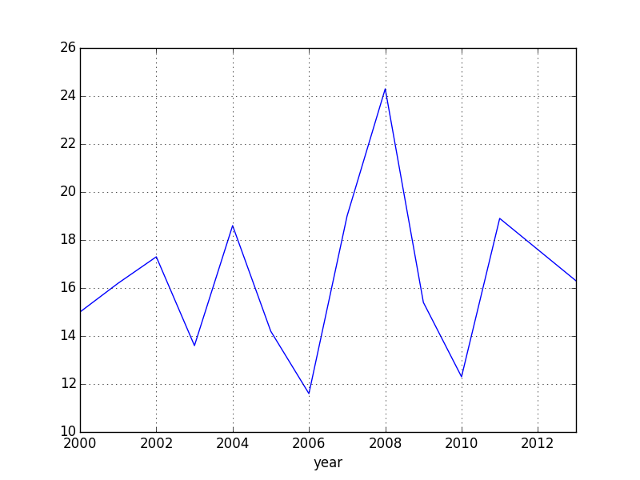
?

Slide 3
Provenance
‘Lab notebook’

Slide 4
It must:
Be easy – no effort!
Work with libraries without modification
recipy

Slide 5
WINNERS!
Raquel Alegre, Robin Wilson, Janneke van der Zwaan
#CollabW2015
www.software.ac.uk/cw15

Slide 6
import recipy

Slide 7
import pandas as pd
from matplotlib.pyplot import savefig
data = pd.read_csv('data.csv')
data.plot(x='year', y='temperature')
savefig('graph.png')
data.temperature = data.temperature * 100
data.to_csv('output.csv')

Slide 8
import recipy
import pandas as pd
from matplotlib.pyplot import savefig
data = pd.read_csv('data.csv')
data.plot(x='year', y='temperature')
savefig('graph.png')
data.temperature = data.temperature * 100
data.to_csv('output.csv')

Slide 9
DEMO

Slide 10
import recipy
import pandas as pd
from matplotlib.pyplot import *
data = pd.read_csv('data.csv')
data.plot(x='year', y='temperature')
savefig('graph.png')
data.temperature = data.temperature * 100
data.to_csv('output.csv')
Set up
‘Monkey Patched’
Hooks
DB

Slide 11
Your turn!
pip install recipy
Add pull requests & issues at github.com/recipy/recipy/
Contribute? (code….or money!)
Fill in survey: https://raquelalegre.typeform.com/to/H7wQKZ

Slide 13
‘Monkey Patching’
No on_save hooks
So, change code
at runtime
def wrapped_read_csv(*args):
print('You called read_csv!')
pd.read_csv(*args)
pd.read_csv = wrapped_read_csv
patch_function(mod, f, wrapper_function)

Slide 14
NoSQL Database
Client-Server
Separate installation
Can be remote
Scalable?
Pure Python
No install needed!
JSON-based
Scalability?

Slide 15
sys.meta_path is magic!
1. Find module
Search file system
2. Load module
Load as standard Python module

Slide 16
sys.meta_path is magic!
1. Find module
Search file system Only work with one module
2. Load module
Load as standard Python module
AND patch functions to use wrapper

Slide 17
PatchImporter
PatchSimple
PatchPandas
PatchNumpy
PatchMPL

Slide 18
PatchImporter
Crazy magic!
PatchSimple
Simplification
PatchPandas
PatchNumpy
PatchMPL

Slide 19
class PatchNumpy(PatchSimple):
modulename = 'numpy'
input_functions = ['genfromtxt', 'loadtxt',
'load', 'fromfile']
output_functions = ['save', 'savez',
'savez_compressed', 'savetxt']
input_wrapper = create_wrapper(log_input, 0, 'numpy')
output_wrapper = create_wrapper(log_output, 0, 'numpy')

Slide 20
class PatchNumpy(PatchSimple):
modulename = 'numpy'
input_functions = ['genfromtxt', 'loadtxt',
'load', 'fromfile']
output_functions = ['save', 'savez',
'savez_compressed', 'savetxt']
input_wrapper = create_wrapper(log_input, 0, 'numpy')
output_wrapper = create_wrapper(log_output, 0, 'numpy')

Slide 21
class PatchNumpy(PatchSimple):
modulename = 'numpy'
input_functions = ['genfromtxt', 'loadtxt',
'load', 'fromfile']
output_functions = ['save', 'savez',
'savez_compressed', 'savetxt']
input_wrapper = create_wrapper(log_input, 0, 'numpy')
output_wrapper = create_wrapper(log_output, 0, 'numpy')

Slide 22
What next?
Wrap IO from more packages
Track ‘custom’ packages
Store metadata in output files
Store file hashes
Annotate, export & share runs
Automated testing & better docs

