Slide 1
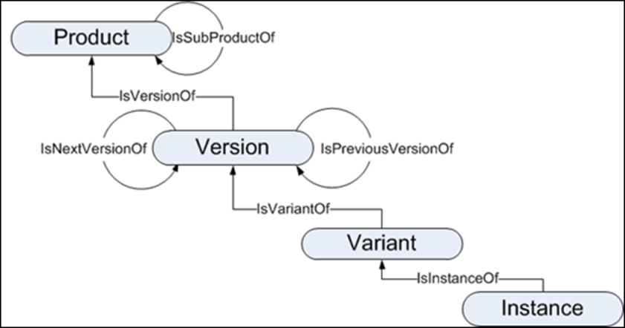
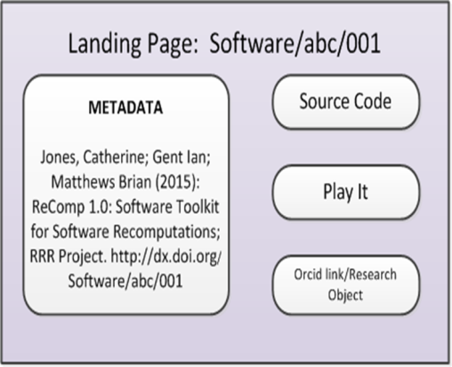
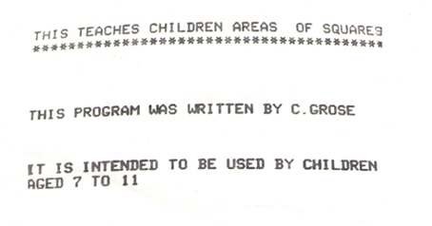
Persistent Identification of Software: a building block to citation & curation
WHY
Software underpins research in many disciplines
Writing software is an intellectual endeavour in its own right: need to cite it
WHAT
HOW/OUTCOME
http://purl.org/net/epubs/work/24058274
OTHERWISE….
Only a printout of photographs of the screen remain, not reusable or citable…
1983 BBC Micro & Basic
Catherine.jones@stfc.ac.uk
B. Matthews, I. Gent, J. Tedds & S Lamerton
Project URL http://rrr.cs.st-andrews.ac.uk/

